Slide 1
Universal Cross-Domain Retrieval: Generalizing Across Classes and Domains
Soumava Paul*, Titir Dutta⁺, Soma Biswas⁺
*Indian Institute of Technology Kharagpur, ⁺Indian Institute of Science Bangalore
This work is partly supported through a research grant from SERB, Department of Science and Technology, Government of India.
Notes:
Hi, I am Soumava Paul. I will be presenting our work “Universal Cross-Domain Retrieval: Generalizing Across Classes and Domains”. This work was done in collaboration with Titir Dutta and Prof. Soma Biswas at IISc. This work is partly supported through a research grant from SERB, Department of Science and Technology, Government of India.

Slide 2
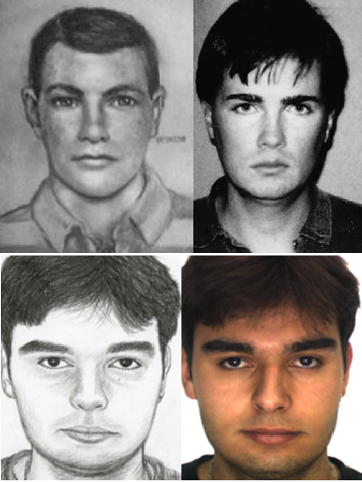
Applications of Cross-Domain Retrieval
Forensics
E-Commerce
Data insufficiency in sketch versus photo face recognition (CVPRW 2012)
A New Algorithm for Sketch-Based Fashion Image Retrieval Based on Cross-Domain Transformation (Wireless Communications and Mobile Computing 2021)
Notes:
Cross-domain retrieval tackles the problem of retrieving relevant data from a domain (say, image), when the query belongs to a different domain (like sketch or painting). One prominent example of cross-domain retrieval is sketch-based image retrieval (SBIR) which has applications in forensics and e-commerce.

Slide 3
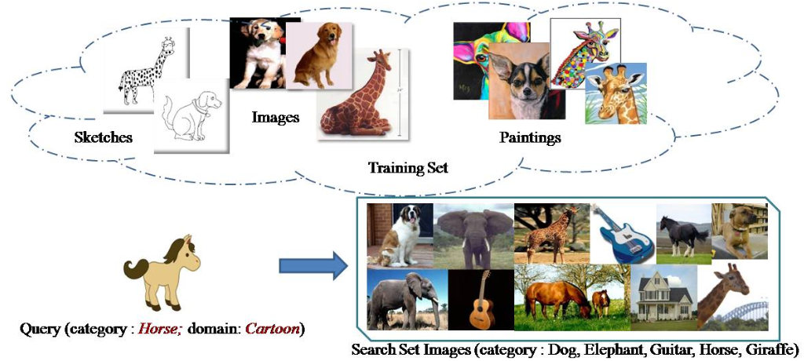
Problem Statement
Universal Cross-Domain Retrieval (UCDR)
Cross-domain retrieval for truly generalized scenario
The query may belong to a seen or an unseen domain
The query may belong to any seen or unseen category
Search set may contain images from seen and/or unseen categories.
First such attempt in retrieval literature
Notes:
In Universal Cross-Domain Retrieval or UCDR for short, we address cross-domain retrieval in a very generalized setting. During testing, the query sample may belong to any seen or unseen domain as well as any seen or unseen class. As is shown in the fig for eg, if a model is trained on animals like dog, giraffe from sketch, image, and painting domains, at test time it can encounter an unknown class - horse from an unknown domain like cartoon. Search set can contain images from seen and/or unseen categories. In this way, our work combines domain generalization with zero-shot cross-domain retrieval and is in fact the first such work in retrieval literature.

Slide 4
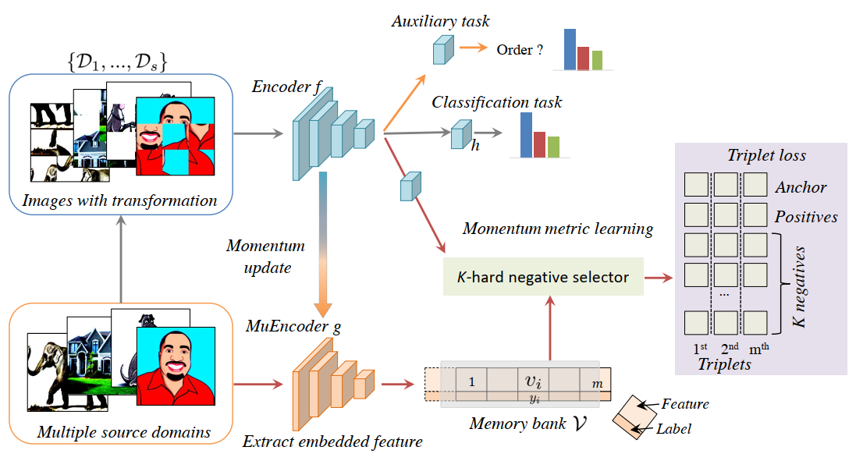
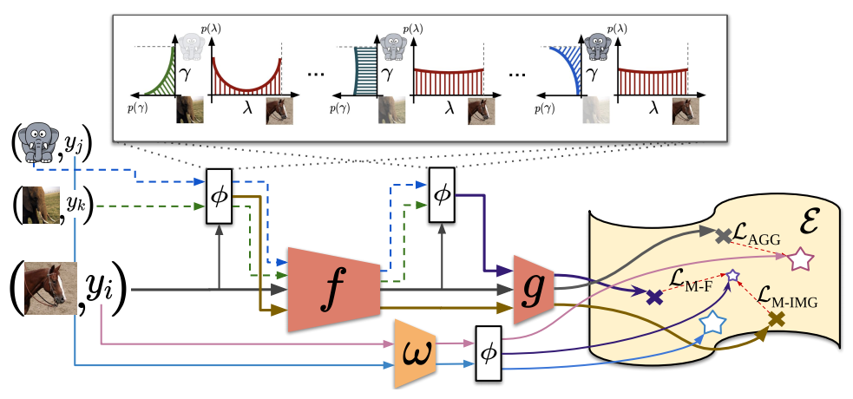
Related Work: Domain Generalization
EISNet (Wang et al., ECCV’20)
CuMix (Mancini et al., ECCV’20)
SOTA performance on domain generalization (DG) task
SOTA performance on zero-shot domain generalization (ZSDG) task
Notes:
Here we talk about the current state-of-the-art methods in domain generalization. EISNet learns a domain-invariant feature representation using the jigsaw puzzle loss, a momentum-based triplet loss on top of a ResNet50 backbone. With this, it achieves sota performance on DG benchmarks like PACS and VLCS. CuMix introduces a curriculum-based mixup technique across domains and classes to learn unknown classes and domains during training through interpolation. It achieves sota performance for the ZSDG task on the domainnet dataset.

Slide 5
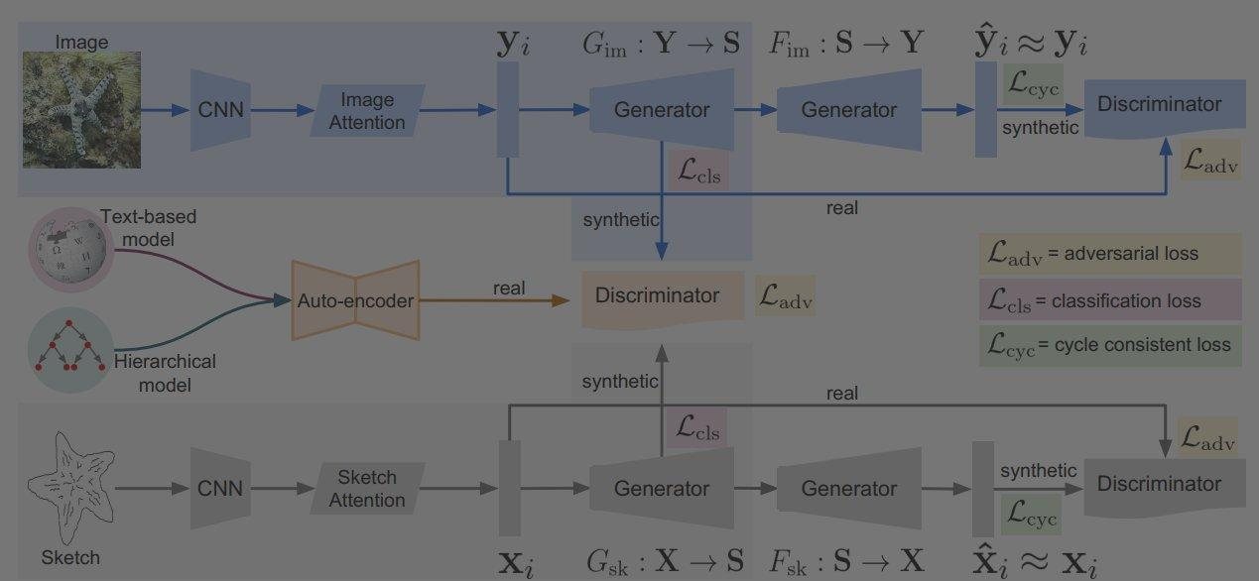
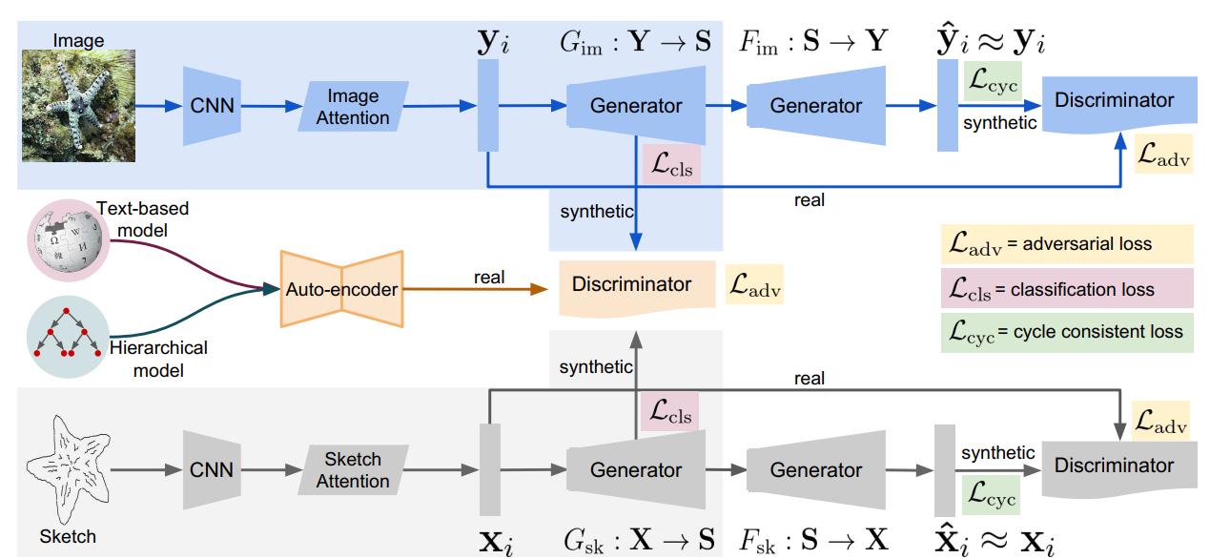
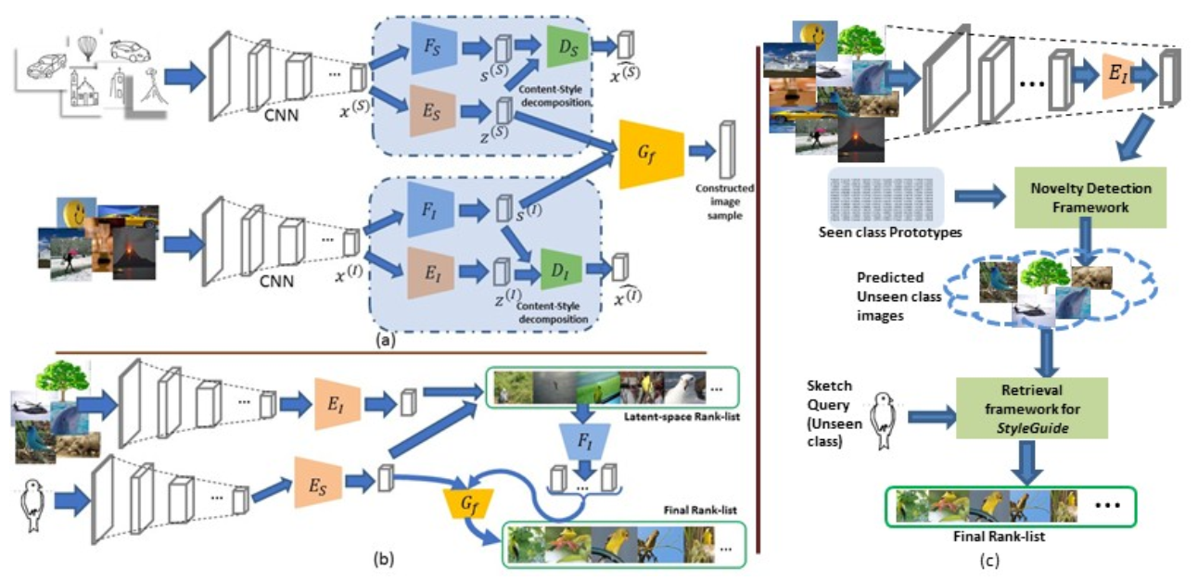
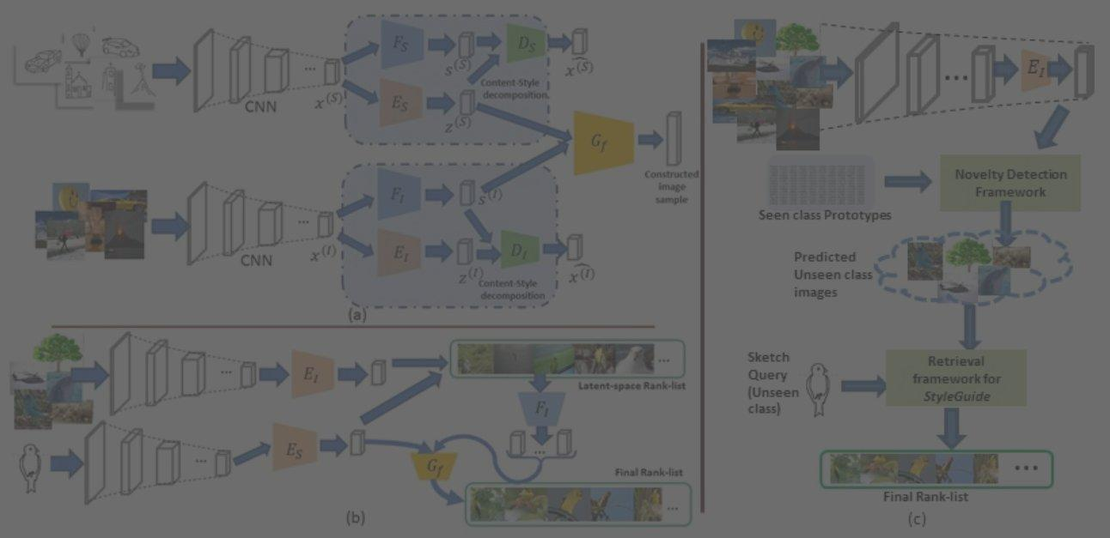
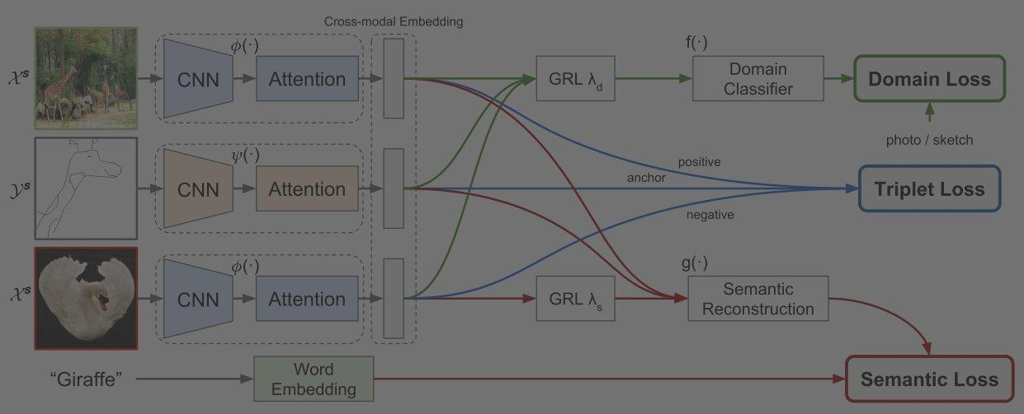
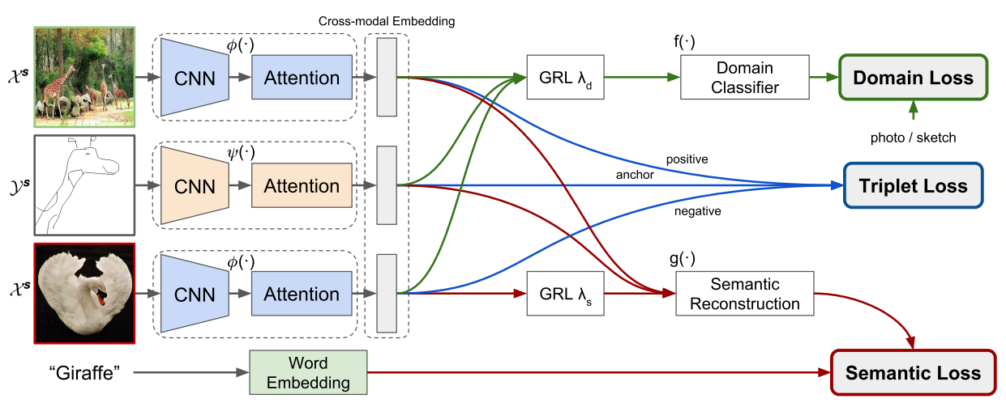
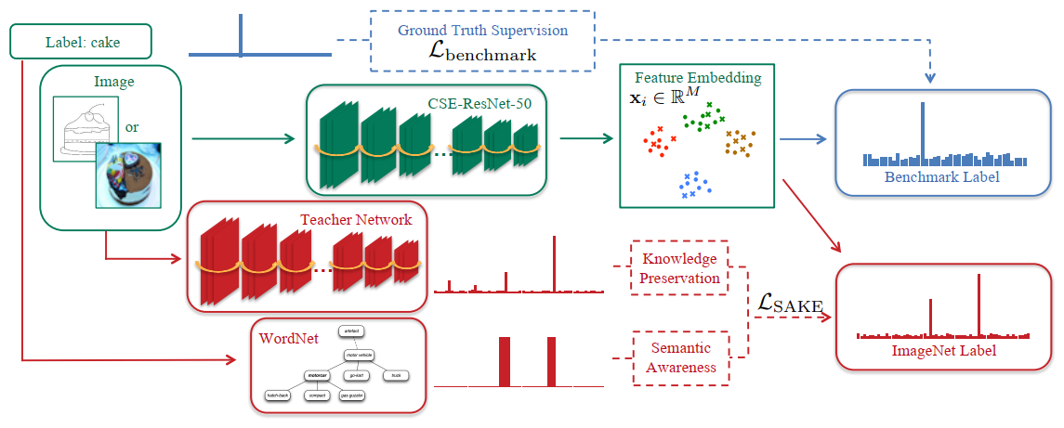
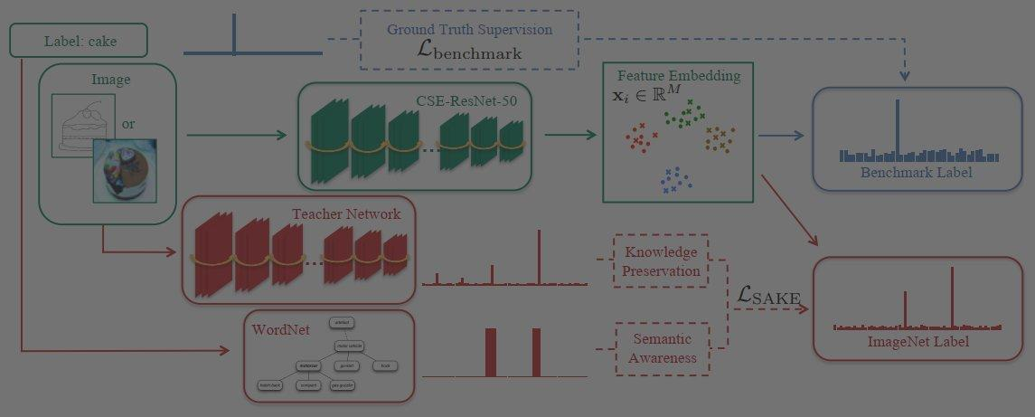
Related Work: ZS-SBIR
Dual Branch Architecture: Domain-independent variant not possible
Dual Branch Architecture: Domain-independent variant not possible
SEM-PCYC (Dutta et al., CVPR’19)
StyleGuide (Dutta et al., BMVC’19)
Dual Branch Architecture with Domain Loss: Domain-independent variant possible
Single Branch Architecture with domain-indicator function: Domain-independent variant possible
Doodle to Search (Dey et al., CVPR’19)
SAKE (Liu et al., ICCV’19)
Notes:
For UCDR, we need to learn a domain-invariant data representation, since we have no prior knowledge about the test domains or categories. Thus, we first explore the zs-retrieval literature to see if they can directly be extended for ucdr problem. SEM-PCYC and StyleGuide are GAN-based models with domain-specific network branches, thus can not generalize directly when an unknown query domain appears during testing. On the other hand, even though Doodle-to-search has a dual-domain architecture, its domain-invariant version is possible. Another recent work SAKE has single-branch with a domain indicator function, and thus can be modified for ucdr.

Slide 6
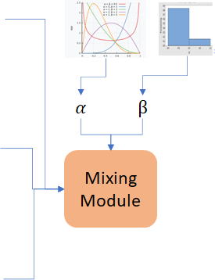
Semantic Neighbourhood and Mixture Prediction Network
Proposed SnMpNet
Mixture Prediction Layer
Class: Bird;
Domain: Image
Base Model
Attention-based SE-ResNet50
Semantic Neighborhood Layer
…
Class: Bird;
Domain: Sketch
Mixed Sample
Class: Clock;
Domain: Sketch
Notes:
Here I describe our proposed Semantic Neighbourhood and Mixture Prediction Network for UCDR. Inspired by the CuMix algorithm, we mix batch samples belonging to multiple classes, as well as multiple domains. Here alpha, sampled from a beta dist and beta sampled from a bernoulli dist are parameters of a mixing module that produces a mixed sample x. In this particular case, we have an inter-class as well as inter-domain mixup of the top image and bottom sketch corr to beta=0. X is next passed through the feature block of a classification network, in our case that being an attention-based SEResnet50 to obtain an embedding g. G is passed through two sets of linear layers - first a mixture prediction layer which ensures g is domain invariant and a semantic neighbourhood layer into a semantic space phi. During training, we learn the phi-space embeddings of seen classes using their semantic information (like glove or word2vec embeddings) and a loss LSn which ensures each class is placed meaningfully wrt its neighborhood classes. This loss also ensures that unseen classes during testing are embedded meaningfully in the phi-space. Finally we also have a mixup-based cross-entropy loss to aid class discriminability. And these blocks together form our SnMpNet.

Slide 7
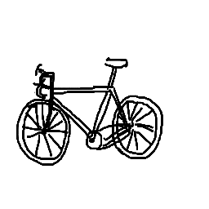
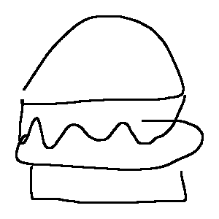
Results: UCDR Evaluation on DomainNet
Query Domain | Method | Unseen-class Search set | Seen + Unseen class Search Set
 |  | mAP@200 | mAP@200
Sketch | EISNet-retrieval | 0.2611 | 0.2286
 | CuMix-retrieval | 0.2736 | 0.2428
 | SnMpNet | 0.3007 | 0.2624
QuickDraw | EISNet-retrieval | 0.1273 | 0.1101
 | CuMix-retrieval | 0.1304 | 0.1118
 | SnMpNet | 0.1736 | 0.1512
Clipart | EISNet-retrieval | 0.3585 | 0.3251
 | CuMix-retrieval | 0.3764 | 0.3428
 | SnMpNet | 0.4198 | 0.3765
Notes:
Here we compare SnMpNet to retrieval versions of EISNet and CuMix on the Domainnet dataset. Here the query domain as well as category are unseen during training. The results are produced by the leave one domain out strategy, followed in DG/ZSDG. The search set can be composed of only unseen or seen + unseen category images. As we can see, SnMpnet outperforms both these models on mean average precision by a significant margin.

Slide 8
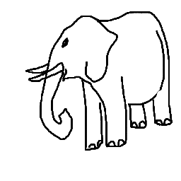
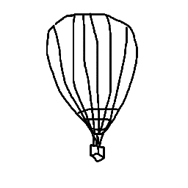
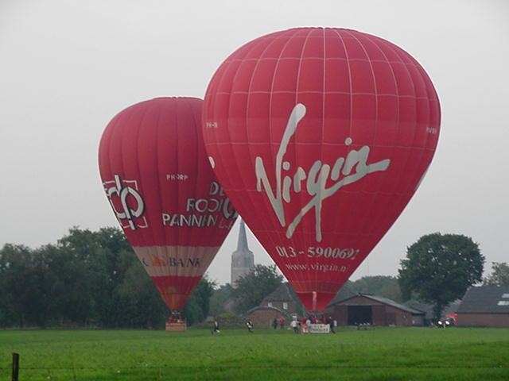
Results: ZS-SBIR Evaluation on Sketchy-extended
Method | mAP@200 | Prec@200
CVAE (ECCV’18) | 0.225 | 0.333
Doodle-to-Search (CVPR’19) | 0.4606 | 0.3704
SAKE-512 (ICCV’19) | 0.6246 | 0.5518
Doodle-SE-SingleNet | 0.4022 | 0.3595
Doodle-SE-SingleNet-w/o Label | 0.3980 | 0.3508
SAKE-512-w/o Label | 0.5484 | 0.4880
SnMpNet | 0.5781 | 0.5155
Notes:
Here we compare SnMpNet to domain-specific models like doodle2search and SAKE on a ZS-SBIR benchmark - Sketchy extended. For fair comparison, we construct domain-invariant versions for these methods such that no domain label is used during training. As we can see, SnMpnet outperforms these variants on the 2 retrieval metrics - mAP@200 and prec@200 and is second only to the domain-dependent SAKE-512.

Slide 9
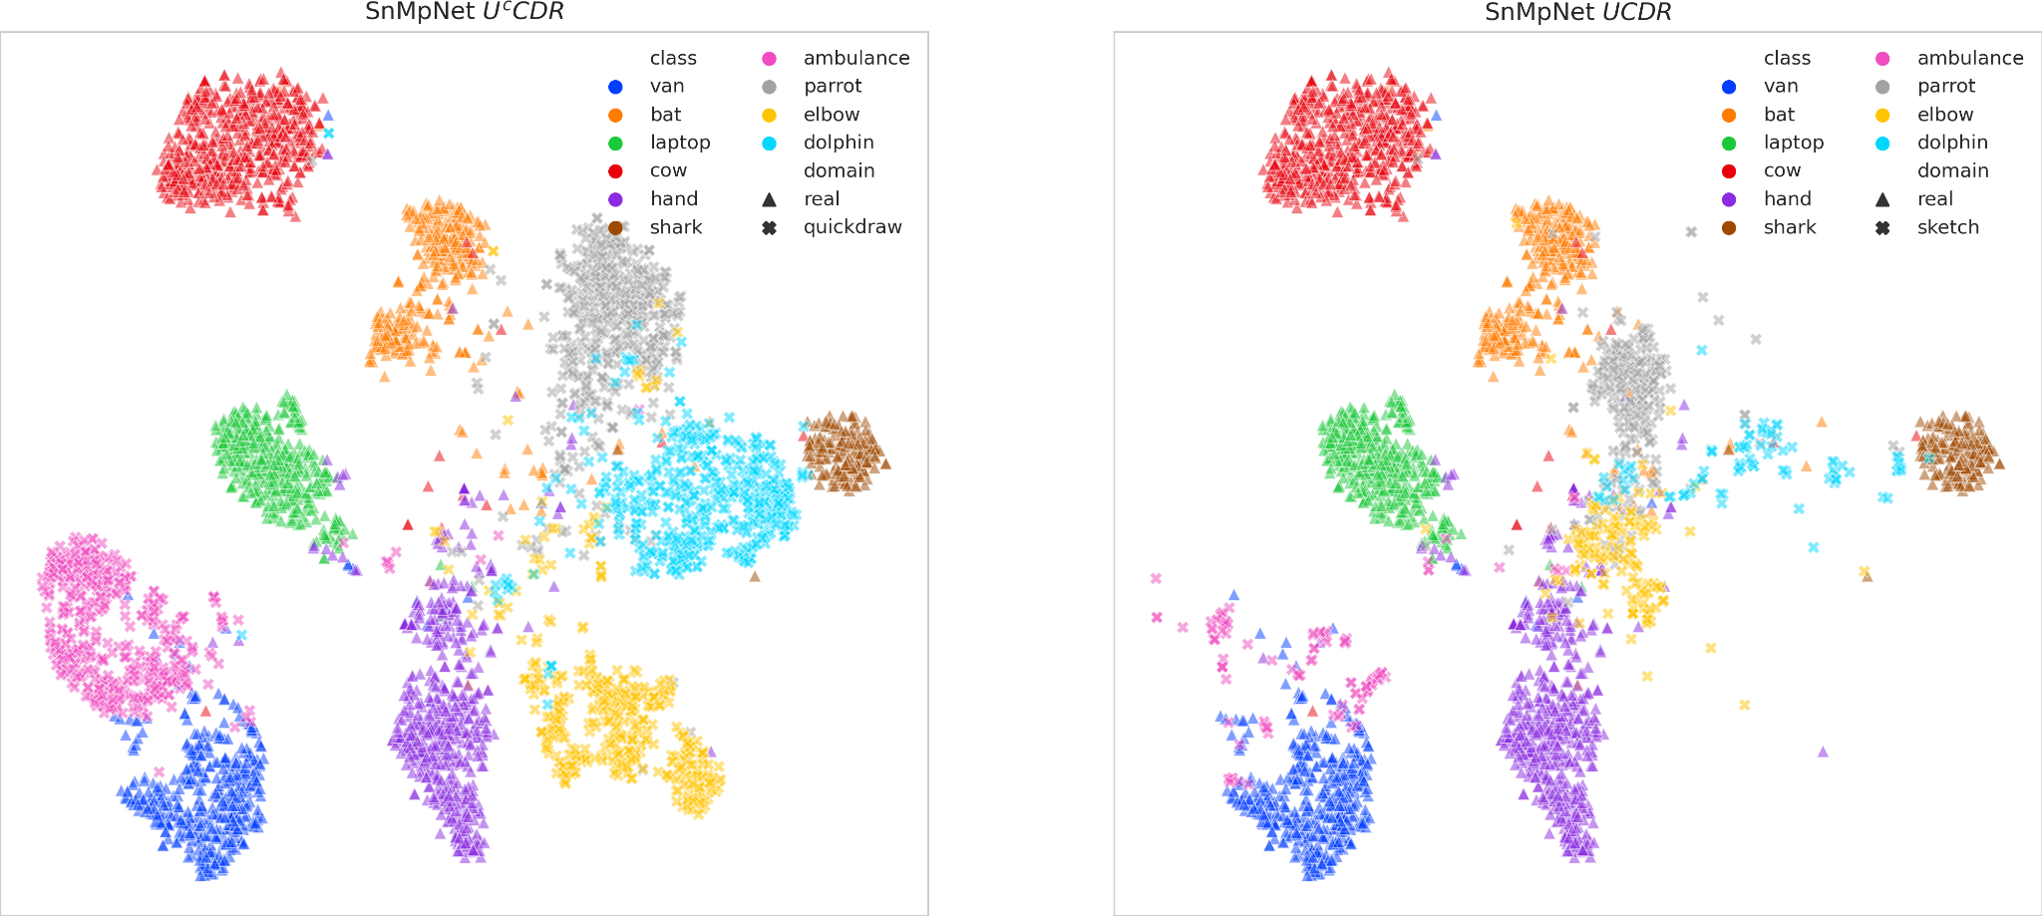
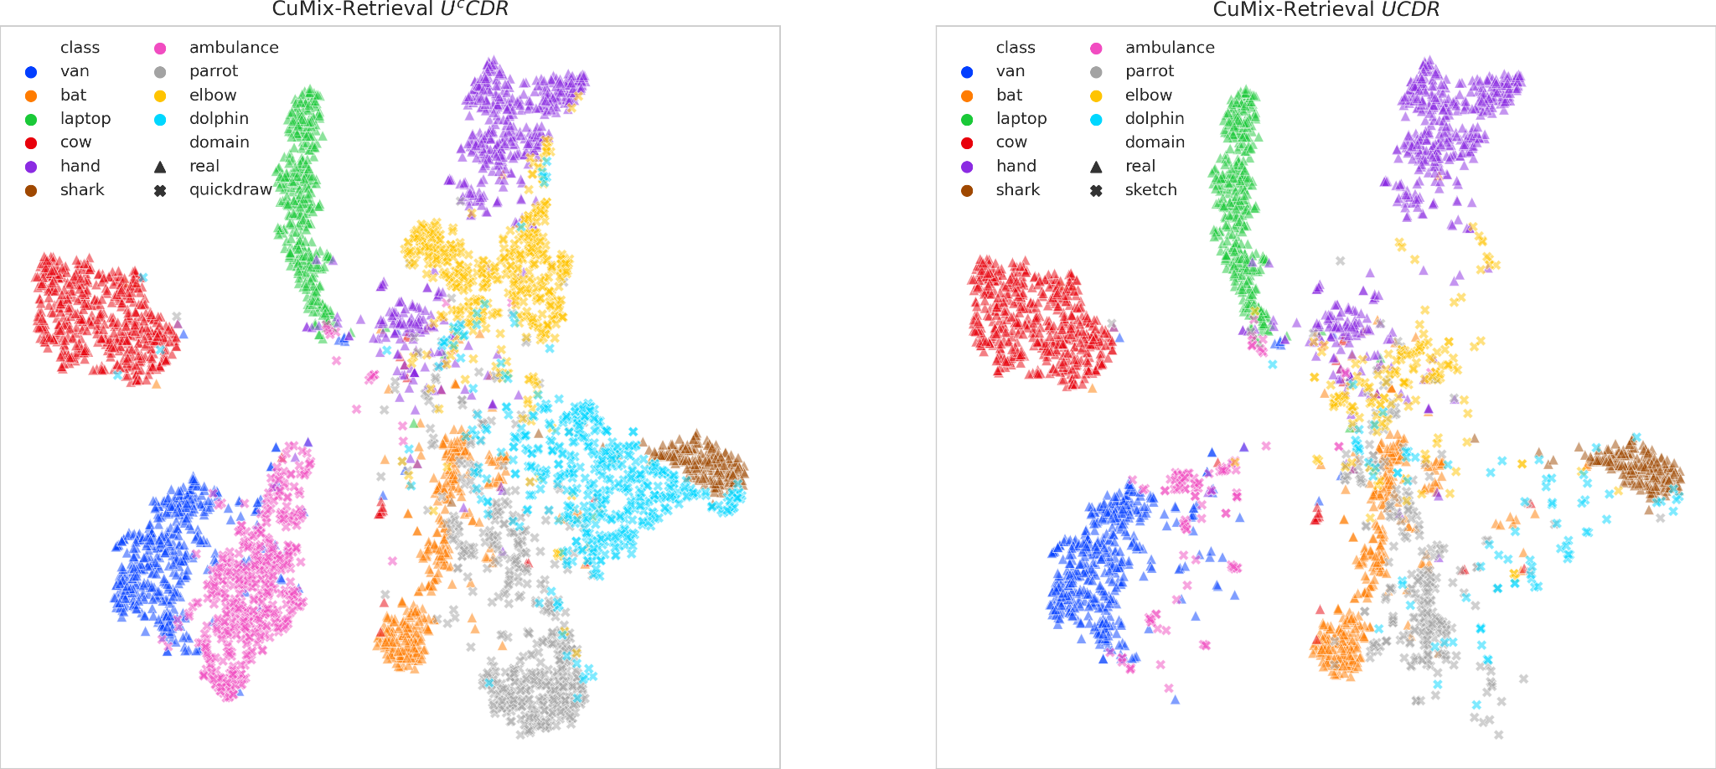
Visualization of Feature Space
Notes:
we present a t-SNE visualization of the feature space learned through SnMpNet and CuMix-retrieval. We project features from 10 selected seen and unseen classes onto the feature-space for a seen (quickdraw) and unseen (sketch) domain. Although CuMix-Retrieval is able to place unseen-classes (ambulance, dolphin, parrot, and elbow) in the neighborhood of the 4 related seen-classes, it is not able to separate the object classes into well-separated clusters for 5 out of the 10 classes. SnMpNet succeeds at both the above objectives and creates distinct cluster boundaries for all classes.

Slide 10
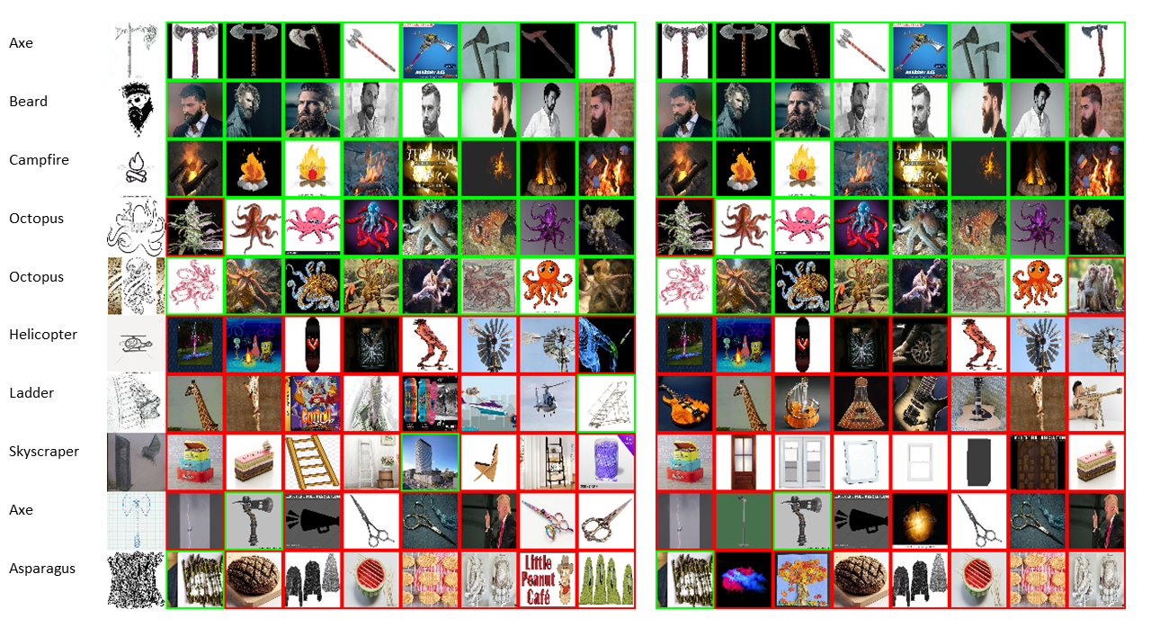
Sample Retrieval Results
Query
Unseen Class Search Set
Seen + Unseen Class Search Set
Notes:
Here we show top-8 retrieval results for some sample sketch queries using SnMpNet. As you can see, retrievals for first 5 queries are quite accurate while there are several incorrect retrievals for the next 5. This mainly happens when the queries are ambiguous and results in retrievals which are either semantically related, or unrelated, but have high shape resemblance with the query. For example campfire(1), windmill(6, 7) are retrieved for helicopter; suitcase(1), cake(2), ladder(3) for skyscraper; lightning(1), megaphone(2) for axe.

Slide 11
Conclusion
We propose a novel framework, SnMpNet for the Universal Cross-domain Retrieval task.
First such work in retrieval literature.
We introduce two novel losses - Semantic Neighbourhood loss and Mixture Prediction loss for the UCDR task.
Extensive experiments and comparisons on two large-scale datasets (Sketchy and DomainNet) show effectiveness of our method.
Paper: http://arxiv.org/abs/2108.08356
Code: https://github.com/mvp18/UCDR
Paper Session: 9A and 9B
Notes:
In summary, .. To know more about our work, you can check out our paper on arXiv and our code is available on this url. Also, if you are attending ICCV, you can visit our poster in paper sessions 9A and 9B.

Slide 12
Thank You!
Notes:
Thanks for listening!

